Slide 1
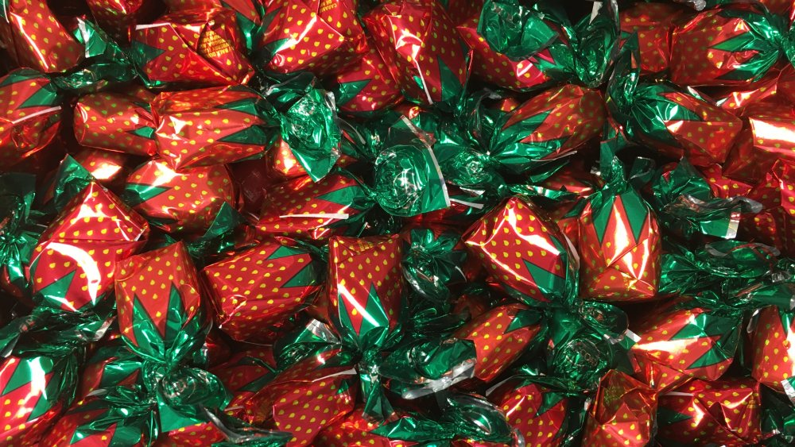
Reward Capture Literature Review
Jonathan Yuquimpo

Slide 2
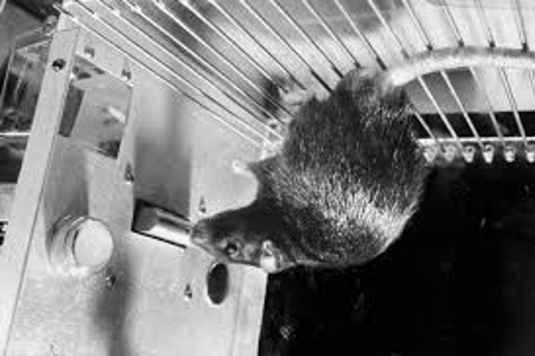
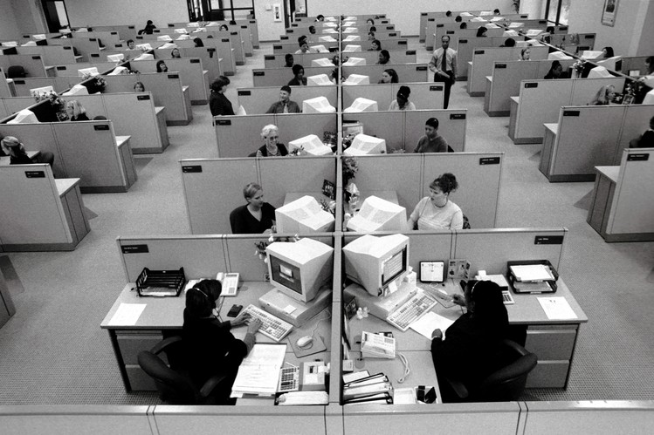

Slide 3
How reward impacts cognition
Reward drives attention
Reward drives attention
Attention drives memory

Slide 4
How reward impacts cognition
Reward
Selective Attention
Visual Working Memory

Slide 5
Top Down
Goal Driven
Bottom Up
Stimulus Driven

Slide 6
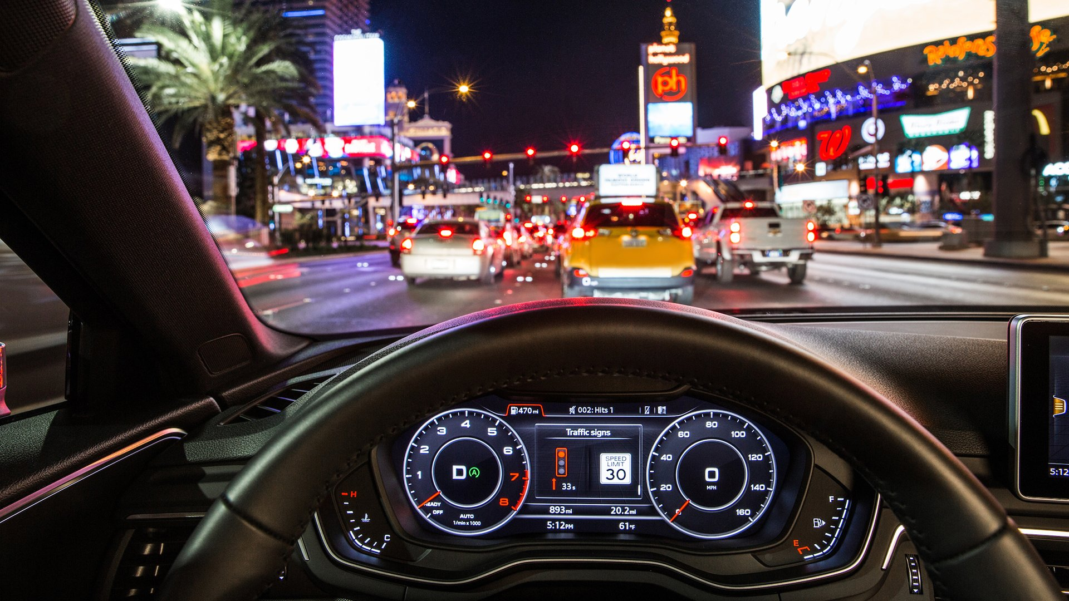

Slide 8
Top Down
Goal Driven
Selection History &
Reward
Bottom Up
Stimulus Driven

Slide 9
Top Down
Goal Driven
Selection History &
Reward
Bottom Up
Stimulus Driven

Slide 10

Learning Phase
Test Phase
+ $0.05
$10.05 total
1500 ms
Correct
1000 ms
1000 ms
1000 ms or until response
1500 ms or until response
400 – 600 ms
400 – 600 ms
Learned value magnifies salience-based attentional capture
Anderson et al., 2011

Slide 11
Learning Phase
Targets
+ $0.05
$10.05 total
Horizontal Target
Vertical Target
1500 ms
High Value Color:
80%: $0.05
20%: $0.01
Low Value Color:
20%: $0.05
80%: $0.01
1000 ms
1000 ms or until response
400 – 600 ms
Learned value magnifies salience-based attentional capture
Anderson et al., 2011

Slide 12
Test Phase
Targets
Horizontal Target
Vertical Target
Correct
High Value Distractors:
High Value Distractors:
1000 ms
1500 ms or until response
400 – 600 ms
Learned value magnifies salience-based attentional capture
Anderson et al., 2011

Slide 13
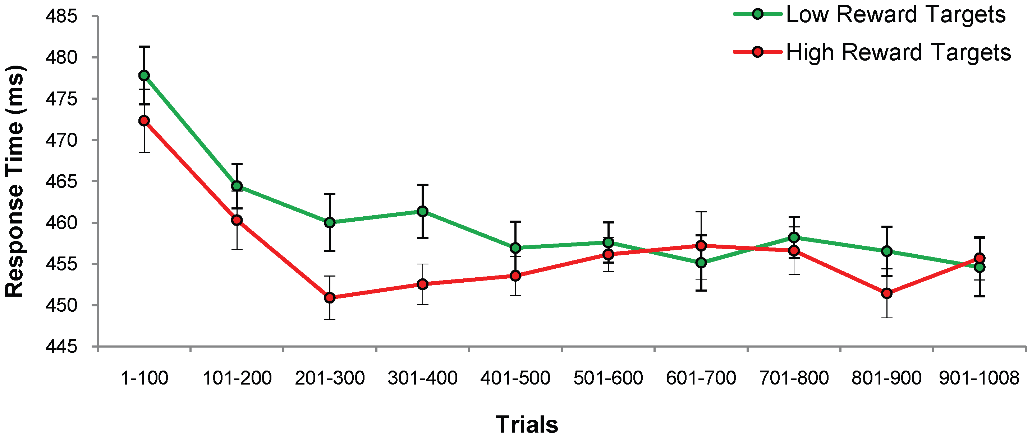
Training Phase: Lower RT for High Reward Targets
n = 18
Anderson et al., 2011

Slide 14
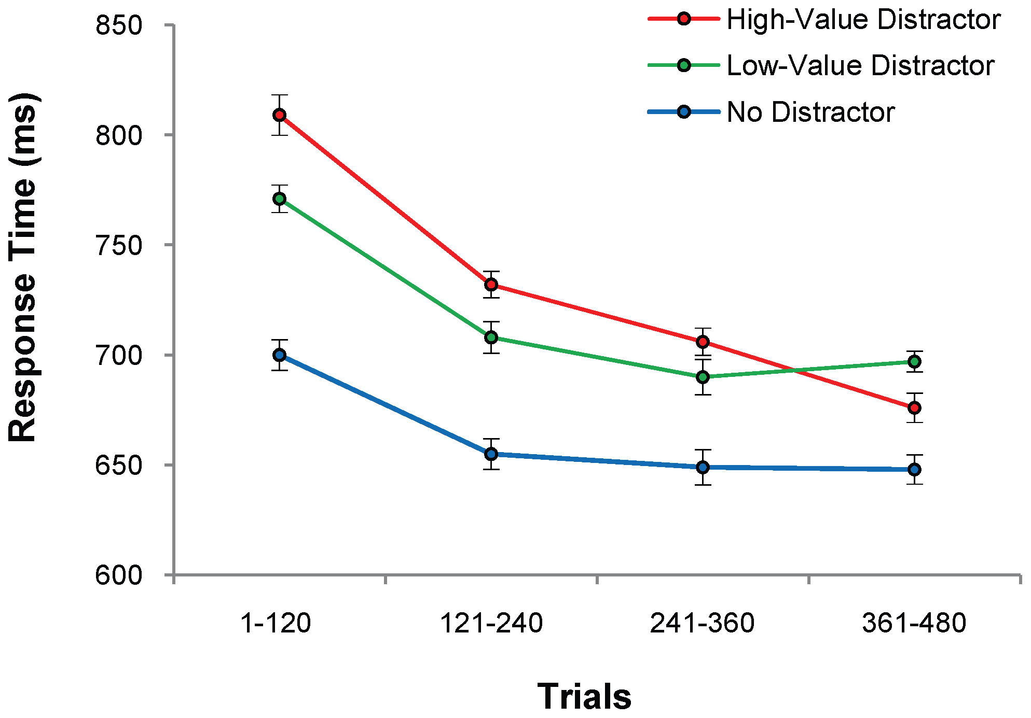
Test Phase: Higher RT for Previously Rewarded Distractors
High-Value: 728 (3.8)
Low-Value: 710 (3.9)
No Distractor: 655 (5.5)
n = 18
Anderson et al., 2011

Slide 15
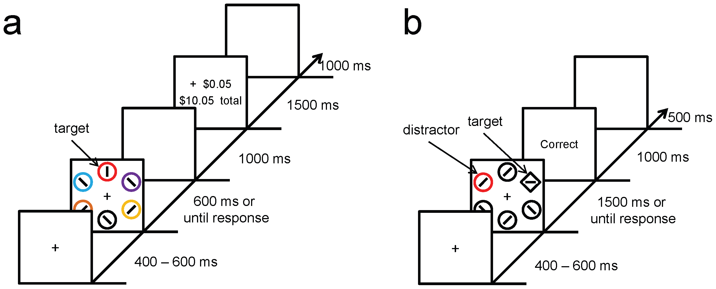
Experiment 2: Isolating Effects of Selection History
Red Targets
Green non-target
No reward feedback given
Compensation based on flat rate
Test phase was kept the same
Anderson et al., 2011

Slide 16
Targets
Correct
Horizontal Target
Vertical Target
High Value Color:
Low Value Color
Correct
Anderson et al., 2011

Slide 17
Targets:
Training Phase
Horizontal Target
Vertical Target
Target Distractor Color:
Non-target distractor color:
Test Phase
Anderson et al., 2011

Slide 18
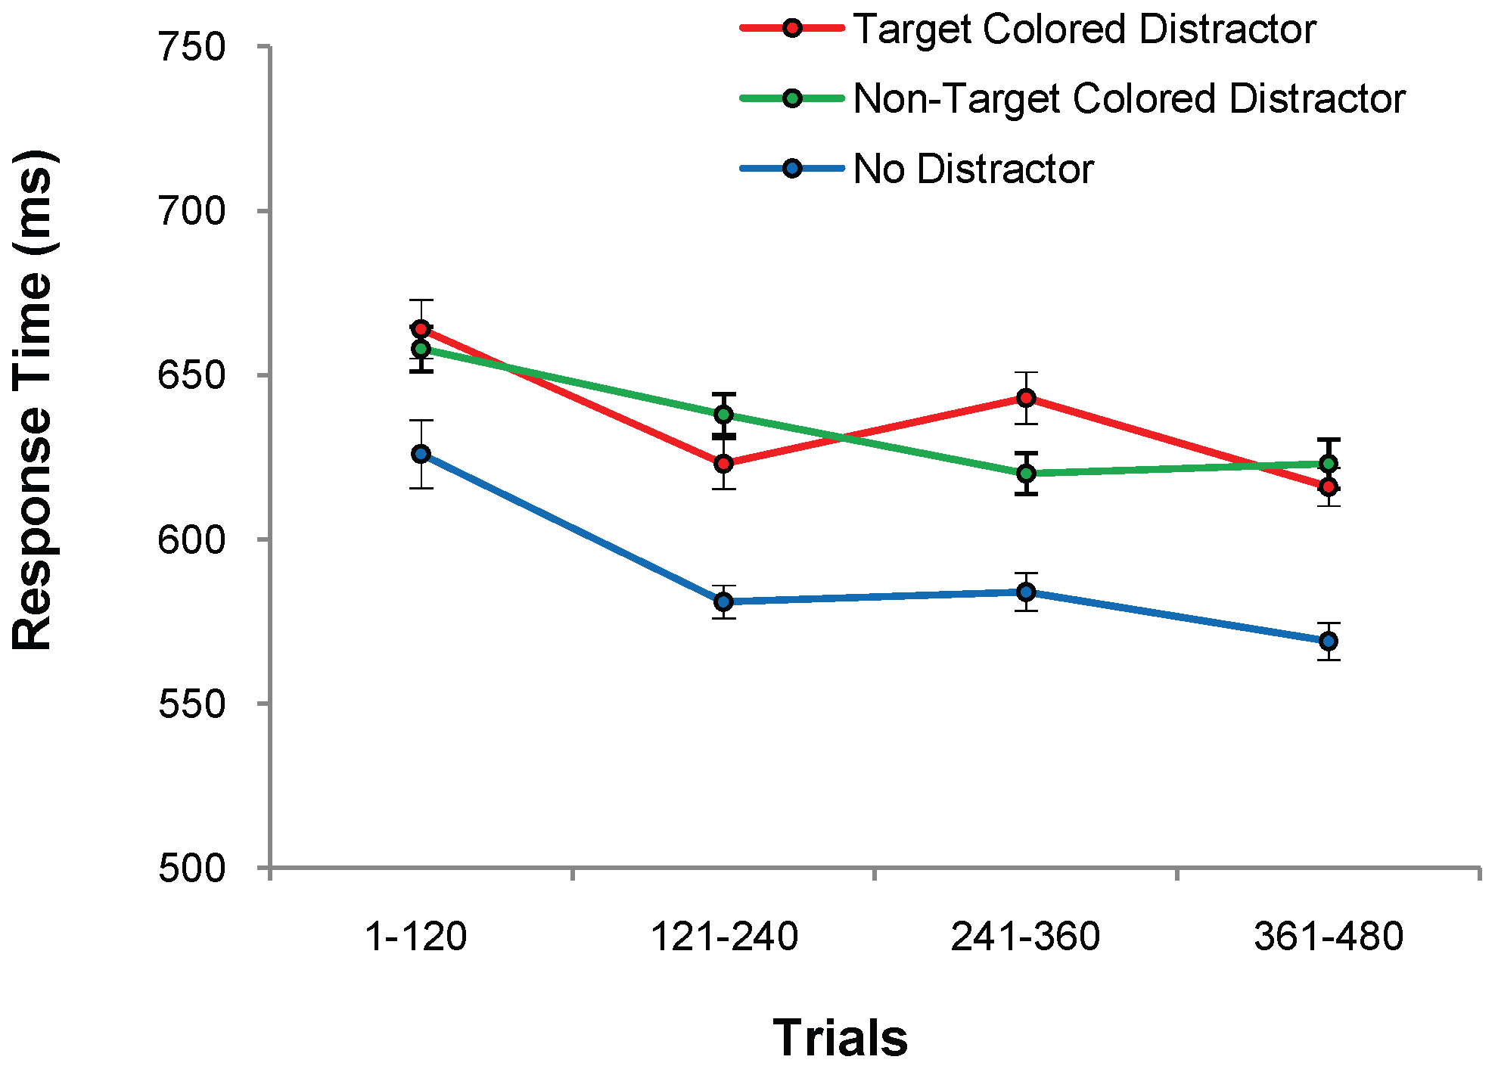
Test Phase 2: No Differences Between Distractor Conditions
Target: 634 (4.8)
Non-target: 632 (4.1)
No Distractor 588 (6.3)
n = 18
Anderson et al., 2011

Slide 19
Rewarded Distractors Resulted in Higher RT
Experiment 1:
Rewards
High Reward: 728 (3.8)
Low Reward: 710 (3.9)
No Distractor: 655 (5.5)
Shows effect of reward
Experiment 2:
Only Selection
Target Distractor: 634 (4.8)
Non-target Distractor: 632 (4.1)
No Distractor: 588 (3.6)
Shows effect of only selection history
Anderson et al., 2011

Slide 20
Summary so Far
Reward-associated stimulus features influence attentional capture independently of physical salience or prior selection history

Slide 21
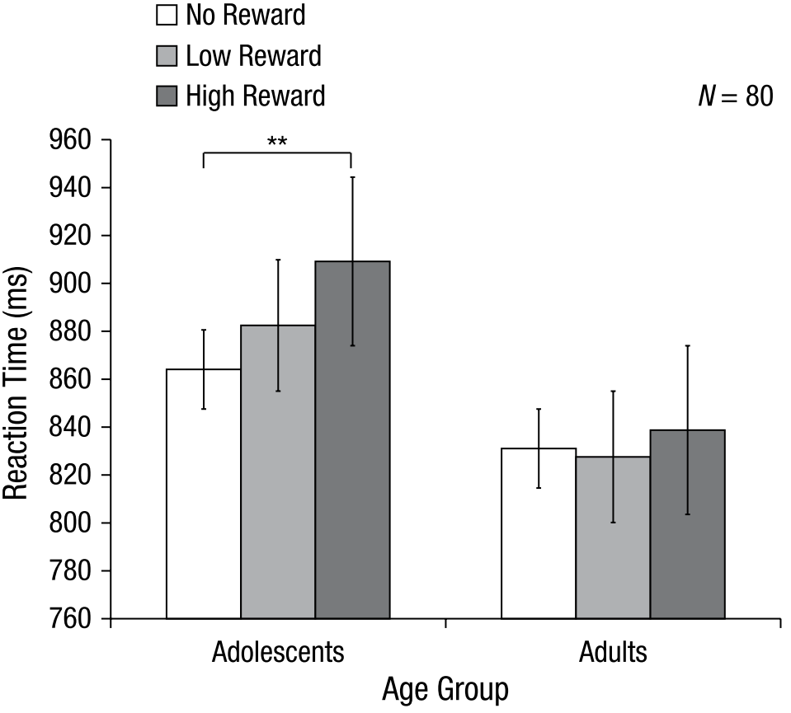
Additional Findings
Anderson, 2017
Mine & Saiki, 2015
Grégoire & Anderson, 2019
Roper et al., 2014

Slide 22
Reward leads to attentional capture
Reward
Selective Attention
Visual Working Memory

Slide 23
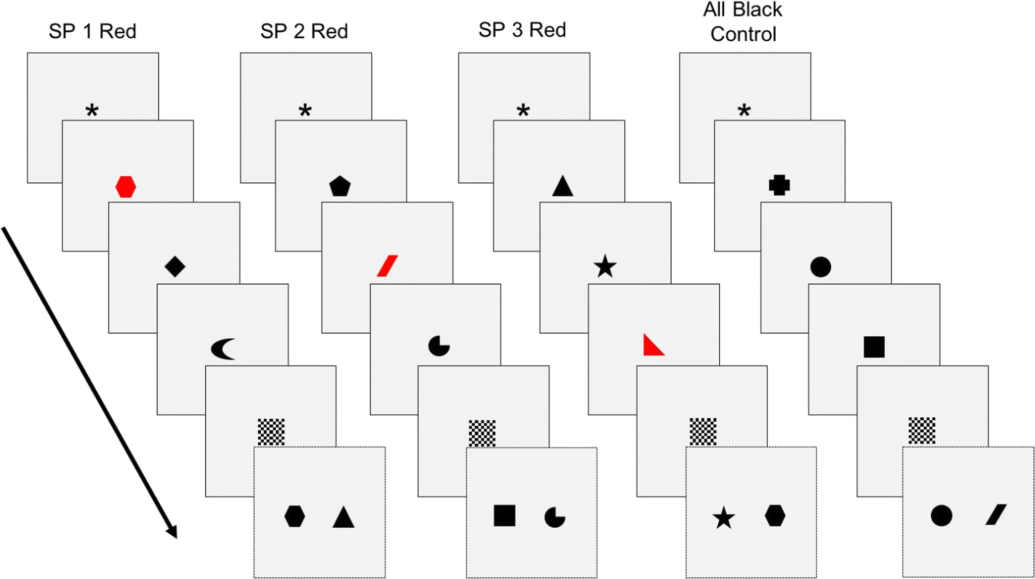
Recognition Task
Each item shown for 0.5s
Black = 3 pts
Red = 25 pts
High-reward vs. Equal-reward
Prioritization within visual working memory reflects a flexible focus of attention
Sandry & Ricker, 2020

Slide 24
Recognition Task
Directions
Characters
Խ Կ Ջ
Sandry & Ricker, 2020

Slide 25
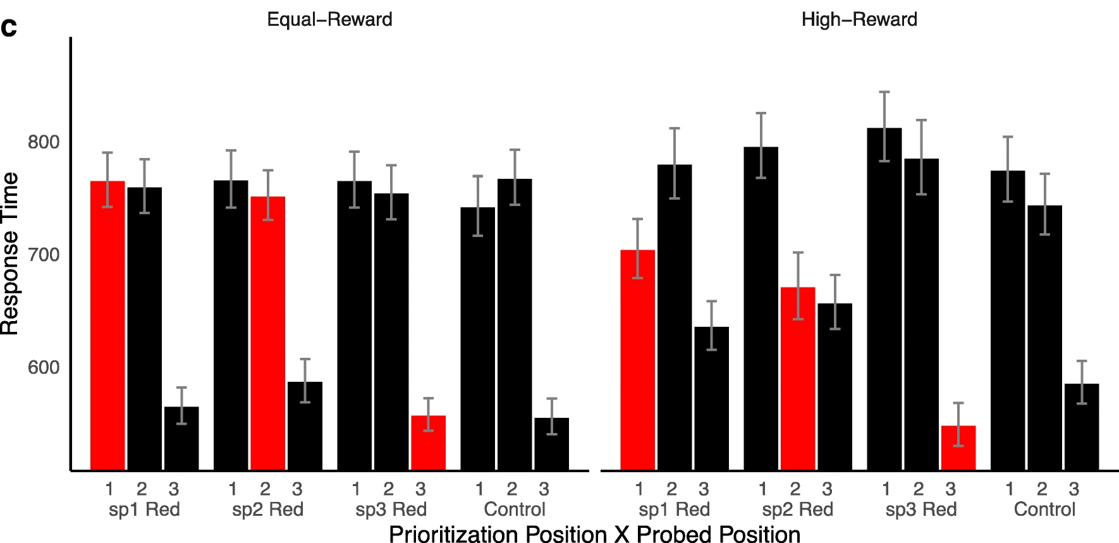
Description of Results

Slide 26
1st item
2nd item
3rd item
Test Item
--Mask--

Slide 27
1st item
2nd item
3rd item
Test Item
--Mask--

Slide 28
1st item
2nd item
3rd item
Test Item
--Mask--

Slide 29
1st item
2nd item
3rd item
Test Item
--Mask--

Slide 30
1st item
2nd item
3rd item
Test Item
--Mask--

Slide 31
1st item
2nd item
3rd item
Test Item
--Mask--

Slide 32
1st item
2nd item
3rd item
Test Item
--Mask--

Slide 33
1st item
2nd item
3rd item
Test Item
--Mask--

Slide 34
1st item
2nd item
3rd item
Test Item
--Mask--

Slide 35
1st item
2nd item
3rd item
Test Item
--Mask--

Slide 36
Effect of High-Reward on Response Time

Slide 37
Effect of High-Reward on Response Time

Slide 38
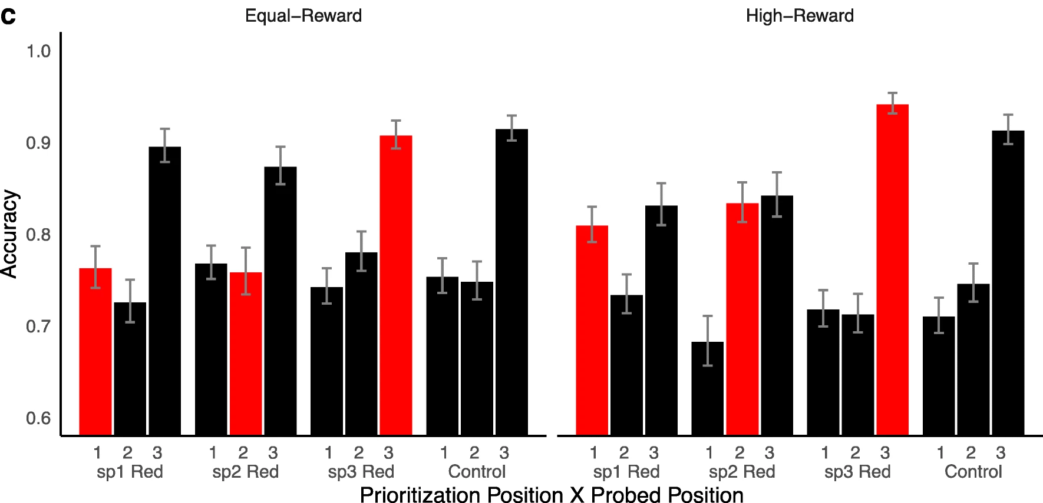
No Effect of High-Reward on Accuracy

Slide 39
Summary so Far
Reward-associated stimulus features influence attentional capture automatically and independently of physical salience or prior selection history
Attention can be flexibly allocated to maintain memory of rewarded stimuli with some resource trade-offs
Sandry & Ricker’s study does not show if the attentional effects of rewarded stimuli automatically transfer over to a memory task
The use of 2AFC prevents discriminability and criterion analyses

Slide 40
Our Study
Anderson Color Association Task
Sandry VWM Task
w/ Modifications

Slide 41
Learning Phase
Test Phase

Slide 42

Learning Phase
Test Phase
A
2500 ms or until response
+ 10 points
42 points total
500 ms
1500 ms
D
500 ms
S
1000 ms
500 ms
1000 ms or until response
A
500 ms
400 – 600 ms
400 – 600 ms

Slide 43
Learning Phase
Green and red targets
200 trials (4 blocks of 50)
Money substituted with points
+ 10 points
42 points total
1500 ms
High Value Color:
80% 10 points
20% 2 points
Low Value Color:
20% 10 points
80% 2 points
1000 ms
1000 ms or until response
400 – 600 ms

Slide 44






List Item
Test Phase
Test Item
High Reward Color
N
A
2500 ms or until response
N
N
500 ms
D
500 ms
S
500 ms
A
500 ms
400 – 600 ms

Slide 45
200 Old/New trials
XX Old & XX New
Green (XX), Red (XX), & No Color Llists (xx0
No reward feedback
Test Phase
A
2500 ms or until response
500 ms
D
List Item
Test Item
500 ms
S
High Reward Color
500 ms
N
A
N
500 ms
N
400 – 600 ms

Slide 46



List Item
Test Phase
Test Item
High Reward Color
N
A
2500 ms or until response
N
N
500 ms
D
Low Reward Color
N
500 ms
S
N
500 ms
A
N
500 ms
No Color
N
400 – 600 ms

Slide 47
Hypotheses
Hypothesis

Slide 48
Learning Phase

Slide 49
Learning Phase
67 online participants
1 excluded due to technical problems
2 due to failing attention checks
+ 10 points
42 points total
1500 ms
High Value Color:
80% 10 points
20% 2 points
Low Value Color:
20% 10 points
80% 2 points
1000 ms
1000 ms or until response
400 – 600 ms

Slide 50
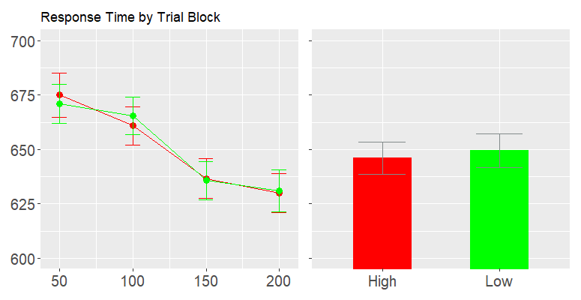
Response Time by Trial Block and Reward Condition
No effect of reward condition
Main Effect of Trial Block
Current Preview 775 x 400
Reward
High
Low
Response Time
Trial Block

Slide 51
Learning Phase – Accuracy
No effect of reward condition
Main Effect of Trial Block
Current Preview 775 x 400
Reward
High
Low
Response Time
Trial Block

Slide 52
Test Phase

Slide 53
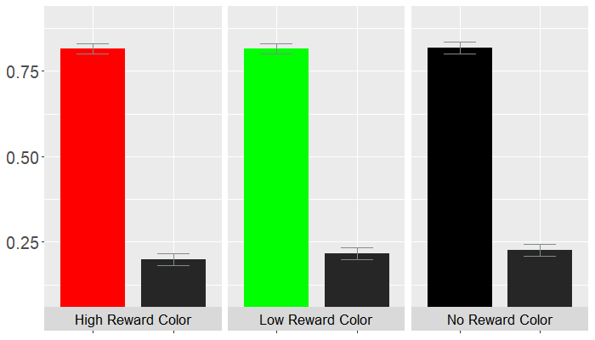
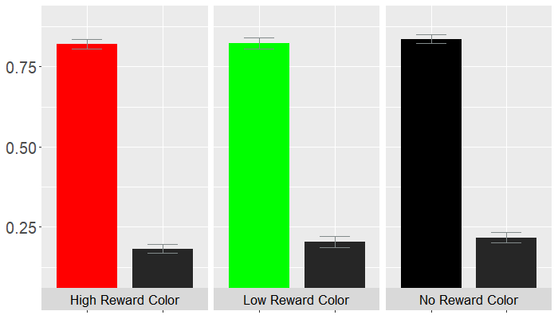
Hit Rate (HR) and False Alarm Rate (FAR) by Reward Condition
Reward
High
Low
None
No main effect of reward on hit rate or false alarm rate
Proportion
HR
FAR
HR
FAR
HR
Trial Block

Slide 54
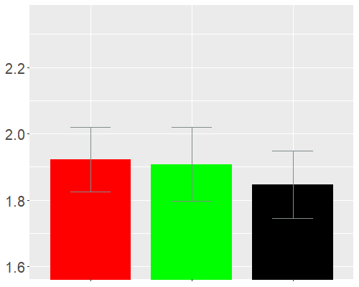
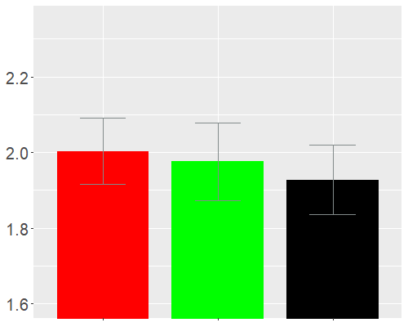
dprime by Reward Condition
Reward
High
Low
None
500 x 400
d-prime (d’)

Slide 55
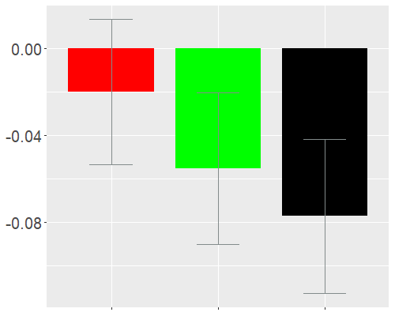
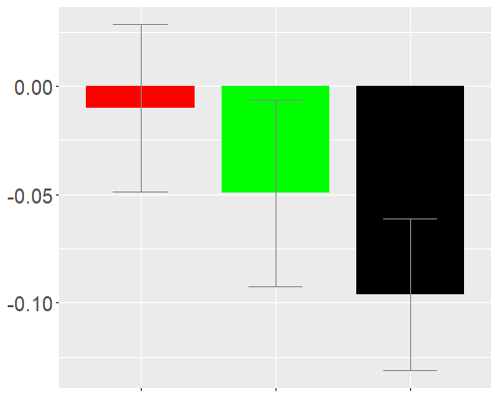
Criterion by Reward Condition
Criterion (c)

Slide 56
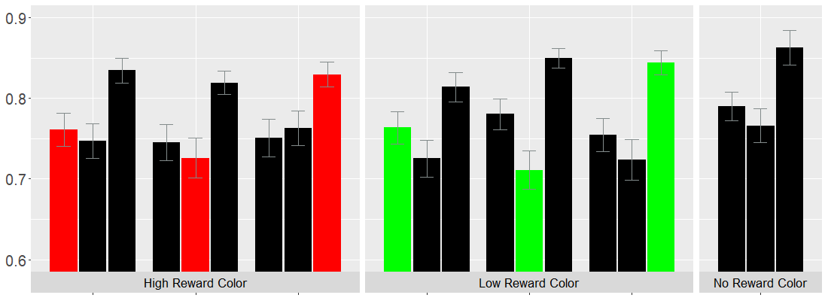
Hit Rate by Reward Condition and Target Position
Reward
High
Low
None

Slide 57
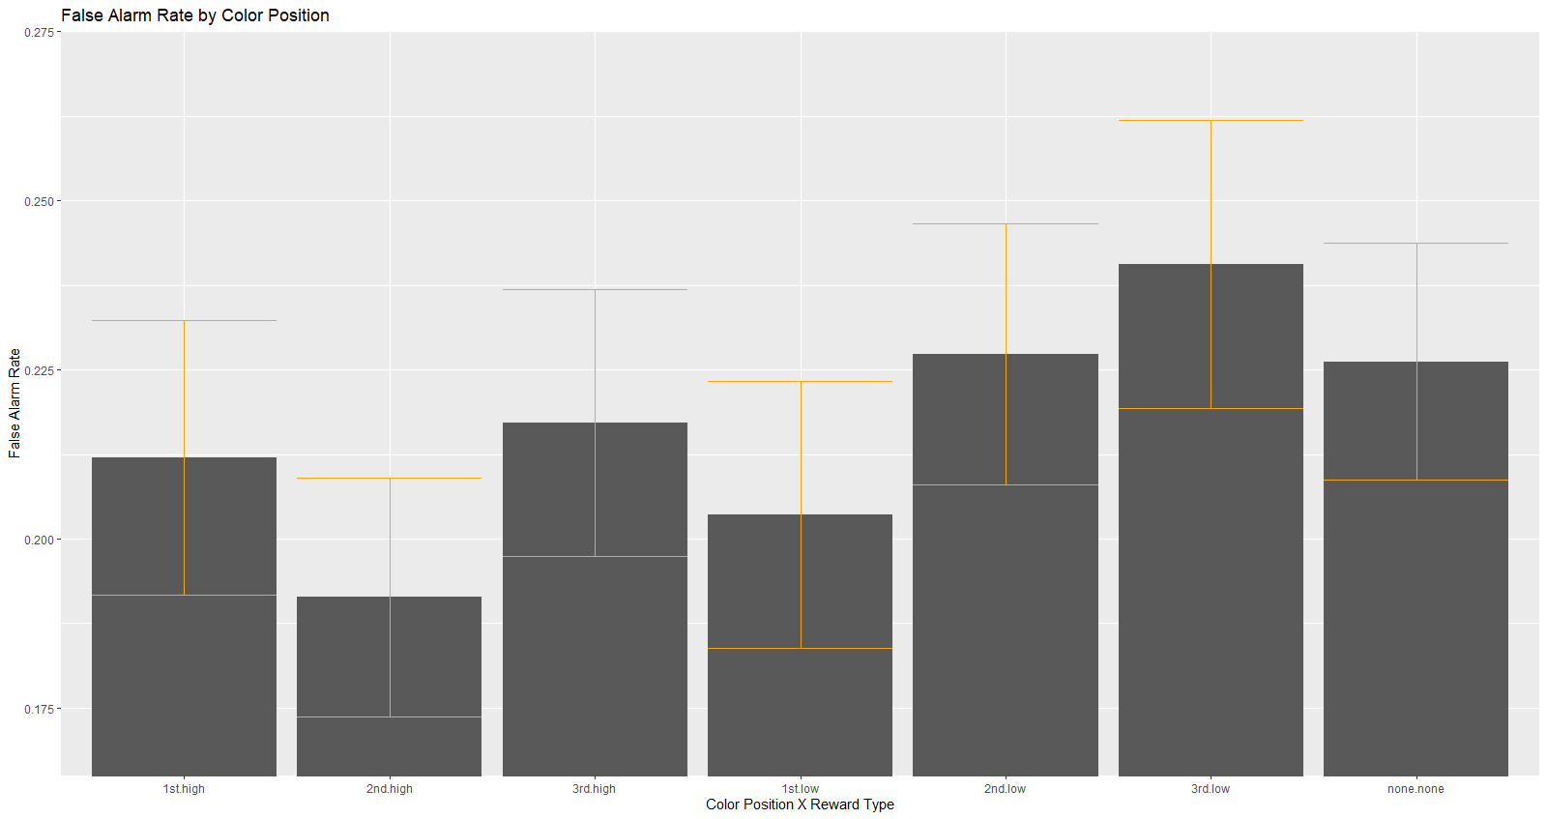
False Alarm Color x Position

Slide 58
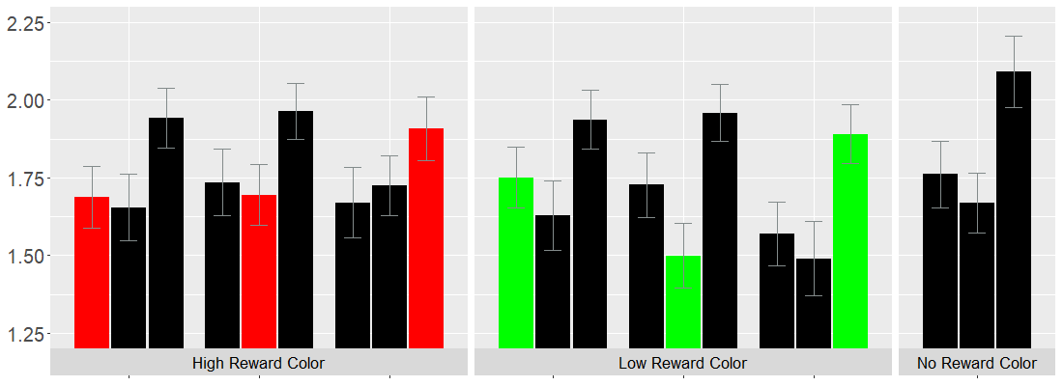
dPrime by Reward Condition and Target Position

Slide 59
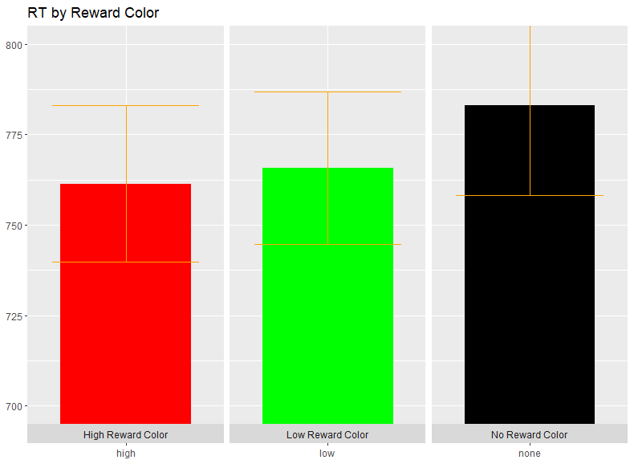
Response Time Color

Slide 60
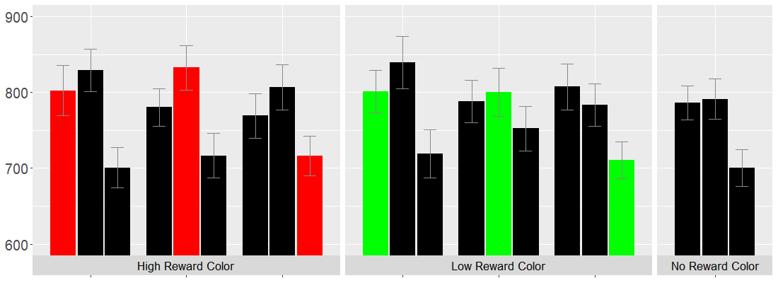
Response Time by Reward Condition and Target Position

Slide 61
